Slide 1


Slide 2


Slide 3


Slide 4
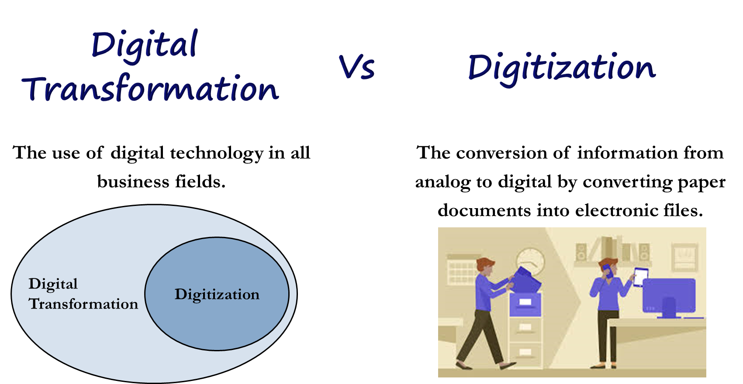

Slide 5
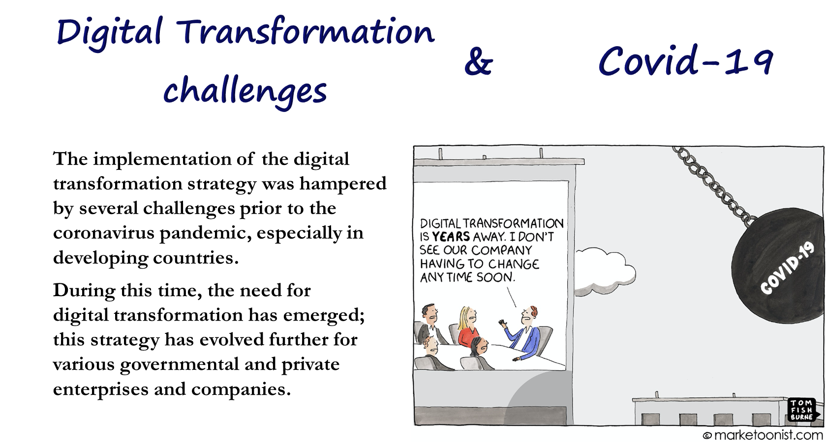

Slide 6
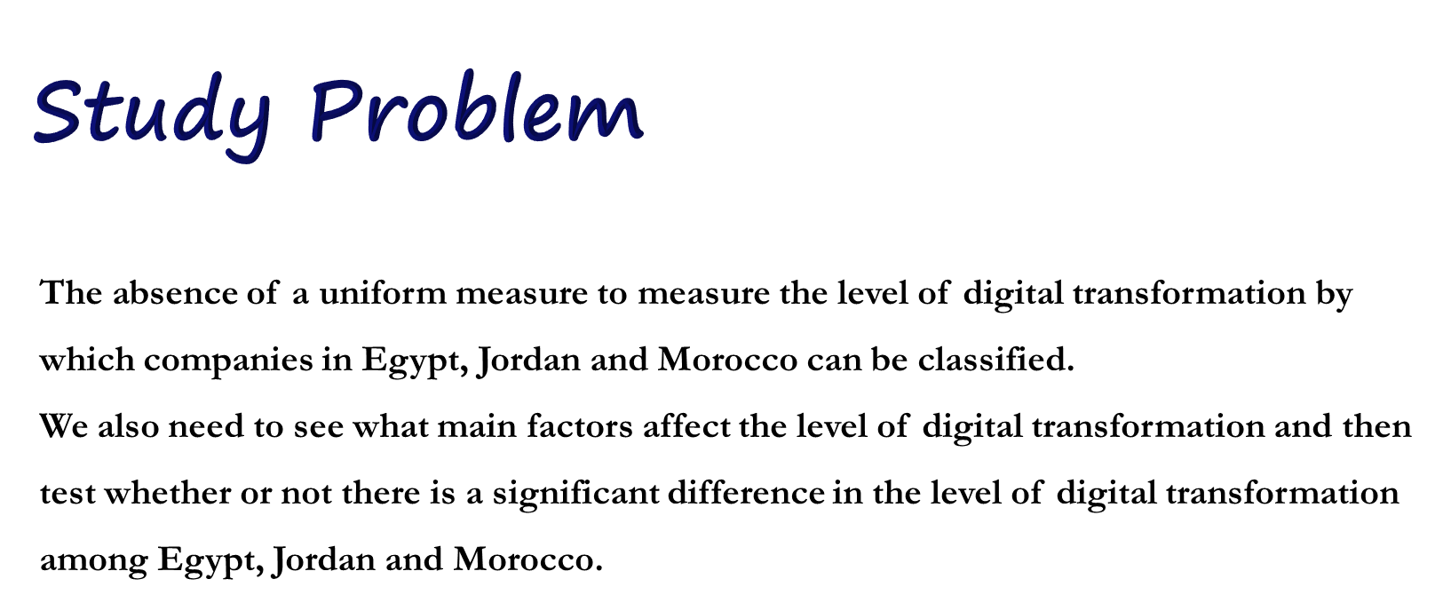

Slide 7
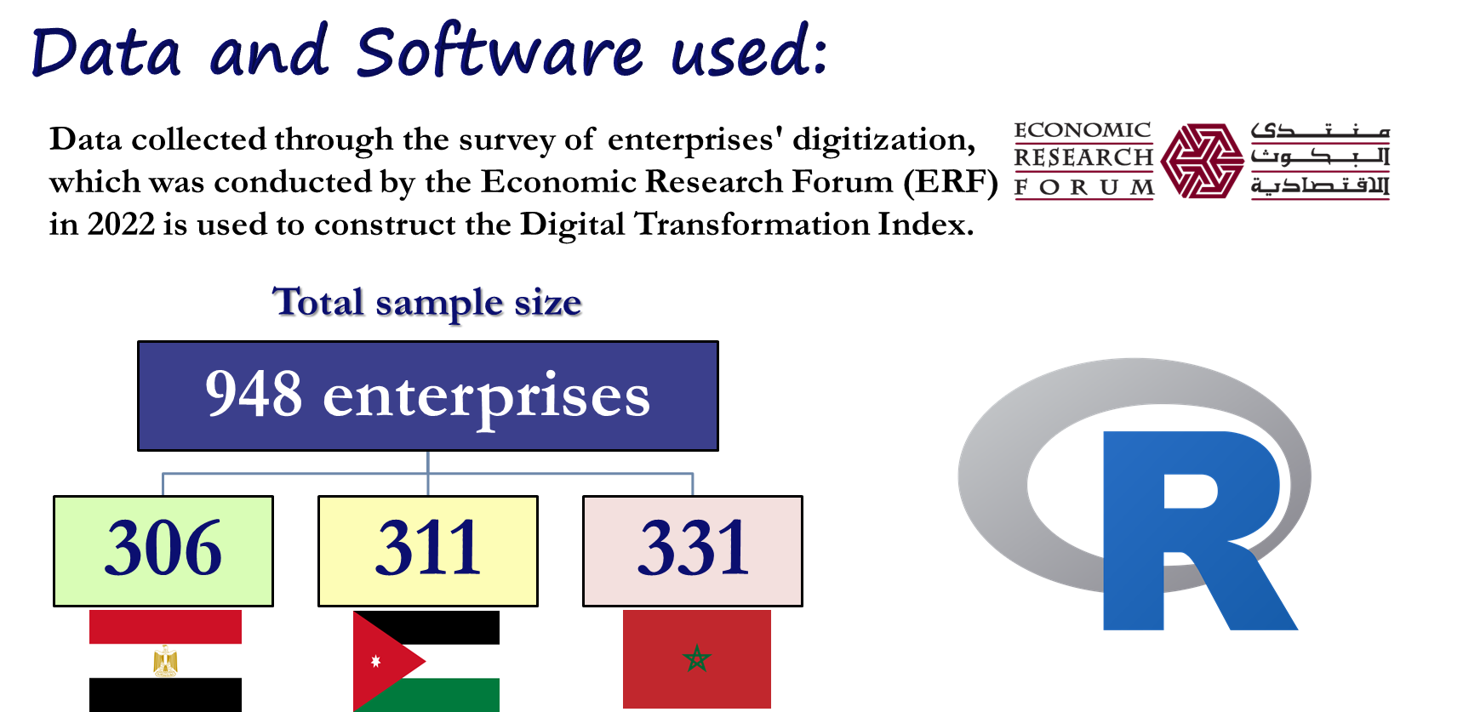

Slide 8
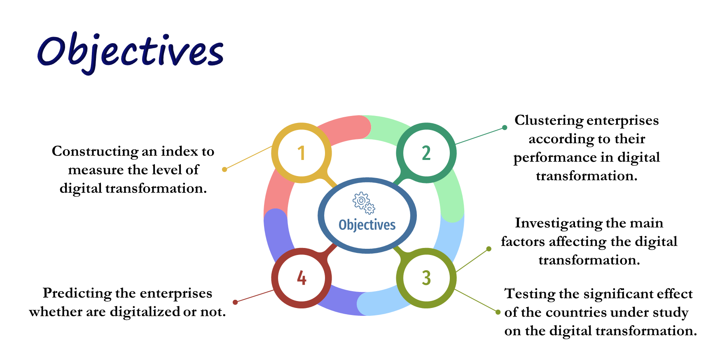

Slide 9
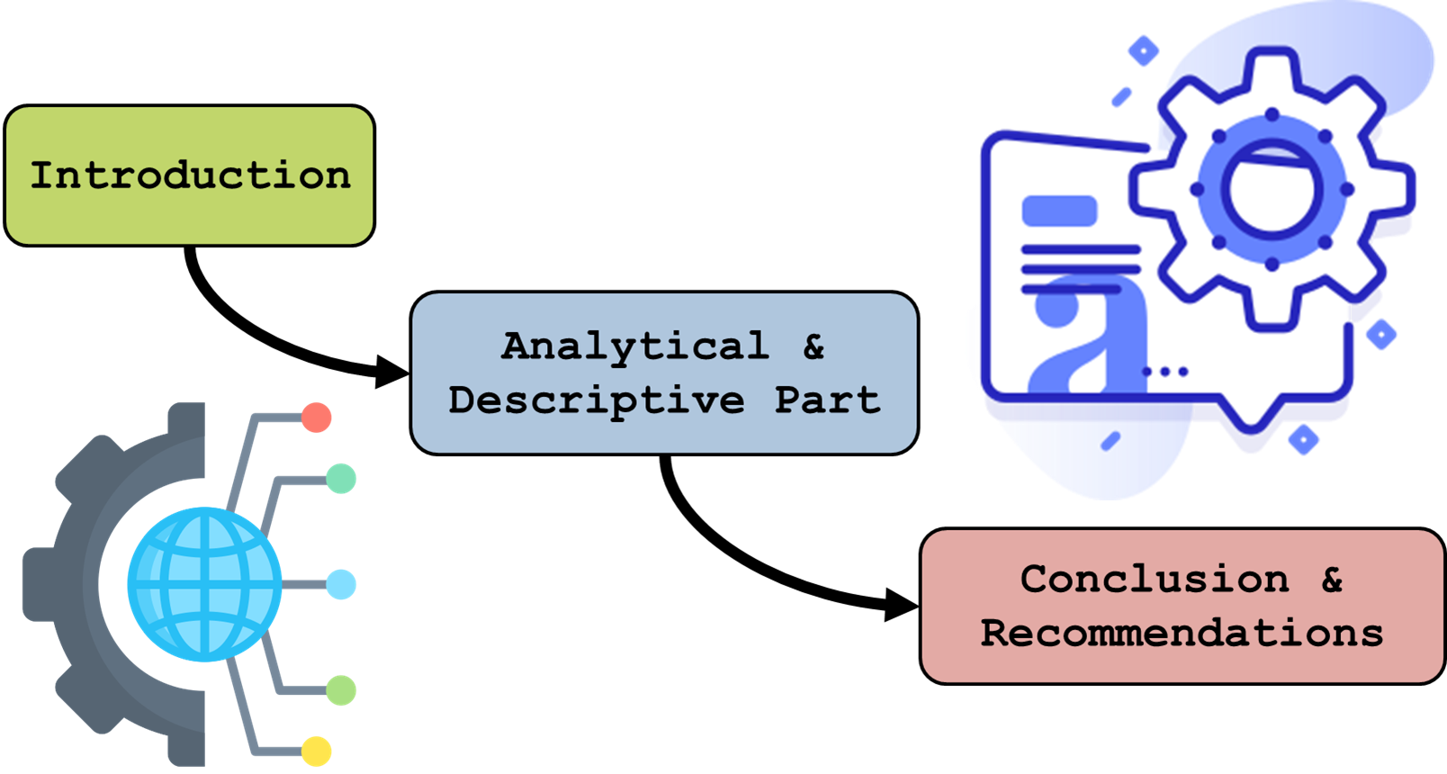

Slide 10
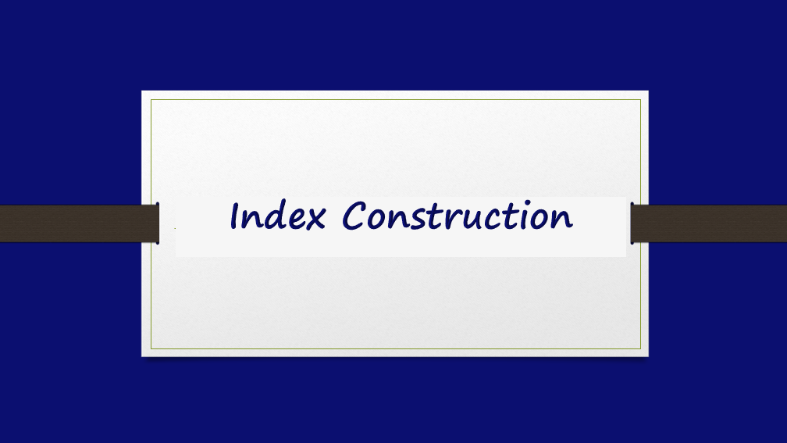

Slide 11
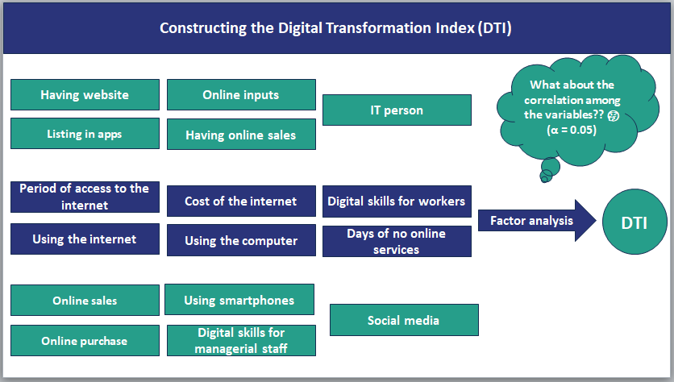

Slide 12


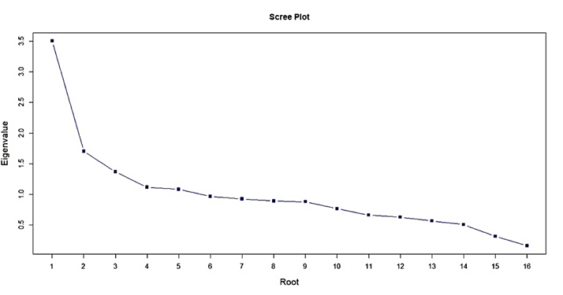
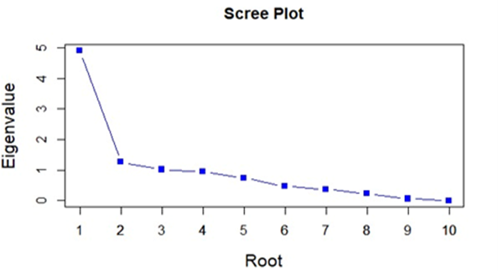
16 variable
Qualitative & Quantitative
10 variables
Qualitative only
We use the
Factor Analysis

Slide 13
The extracted factors from data.
Factors | Proportion of variance | Cumulative proportion of variance
Factor 1 | 0.49 | 0.49
Factor 2 | 0.13 | 0.62
Factor 3 | 0.10 | 0.72
Factor 4 | 0.09 | 0.81
Factor 5 | 0.07 | 0.89
Factor 6 | 0.05 | 0.93
Factor 7 | 0.04 | 0.97
Factor 8 | 0.02 | 0.99
Factor 9 | 0.01 | 1.00
Factor 10 | 0.00 | 1.00

Slide 14
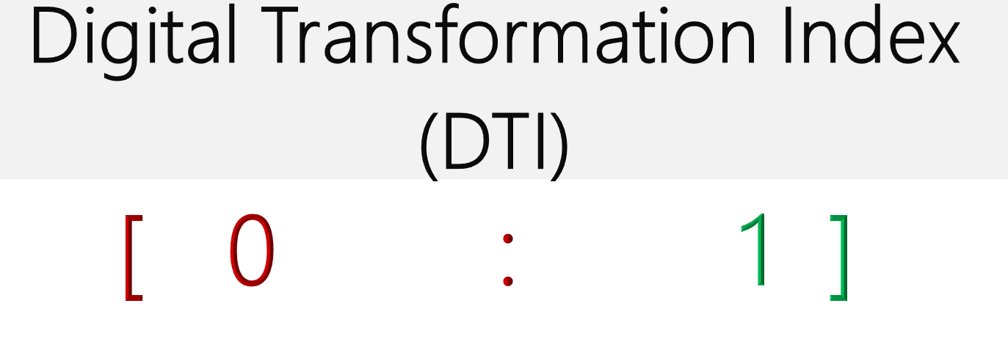
Normalization Technique:
The closer the DTI value to 1, the more digitally transformed the enterprise is.

Slide 15
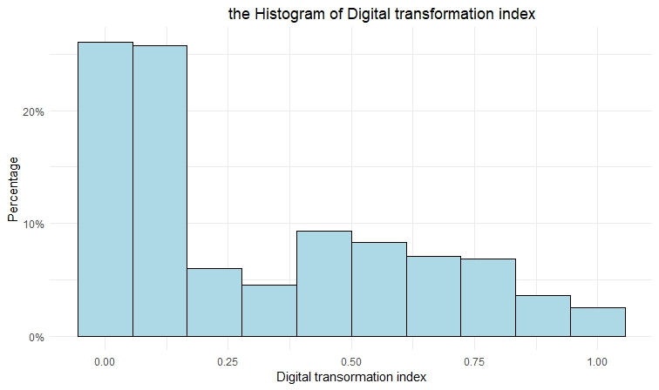
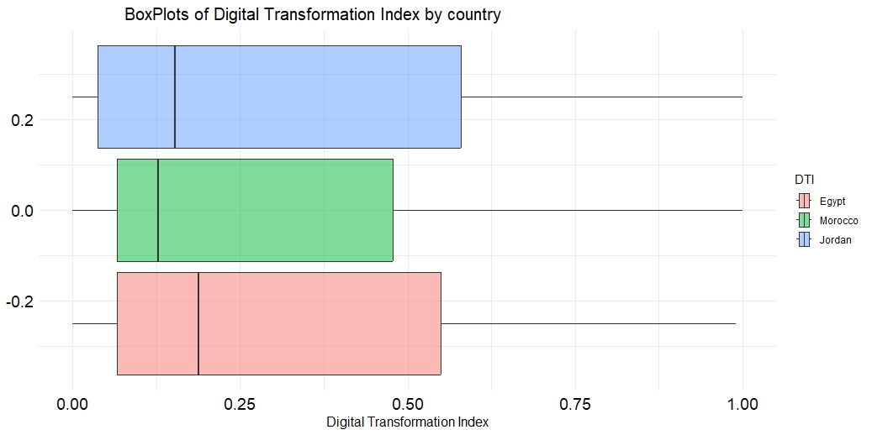
Histogram of the DTI
Testing the normality of the DTI
Test | P-Value
Mardia Skewness | 0.000
Mardia Kurtosis | 0.000
Boxplots of DTI by country

Slide 16
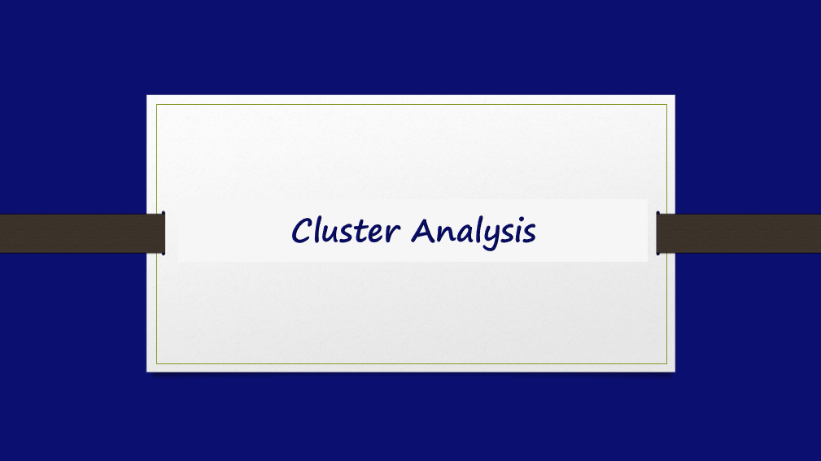

Slide 17
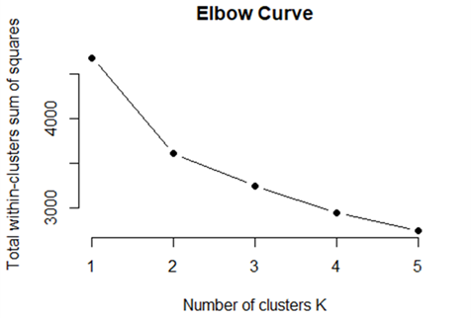
Clustering enterprises according to their performance in digital transformation
To determine the number of clusters:

Slide 18
16 variable
Qualitative & Quantitative
10 variables
Qualitative only
The K-means
The K-modes
Metric | 16 variables | 10 variables
WCSS | 3607.55 | 23.42736
BCSS | 4974.05 | 20810.57
Average Silhouette Score | 0.2365883 | 0.278708

Slide 19
Digitalized
Not-Digitalized
Variable | Cluster 1 | Cluster 2
Having website | Yes | No
Listing in apps | No | No
Online purchase | Yes | No
Online sales | Yes | No
Having online sales | Yes | No
Online inputs | Yes | No
Using smartphones | Yes | No
Digital skills for workers | Yes | Yes
IT person | Yes | No
Social media | Yes | Yes

Slide 20
The Validation using the discriminant correspondence analysis
 | Reference (True) |  | Total
Predicted | Digitalized | Not digitalized
Digitalized | 99 (99%) | 10 (5.4%) | 109 (38.25%)
Not digitalized | 1 (1%) | 175 (94.6%) | 176 (61.75%)
Total | 100 (100%) | 185 (100%) | 285 (100%)
Accuracy = 96.1%
Sensitivity = 99%
Specificity= 94.6%

Slide 21
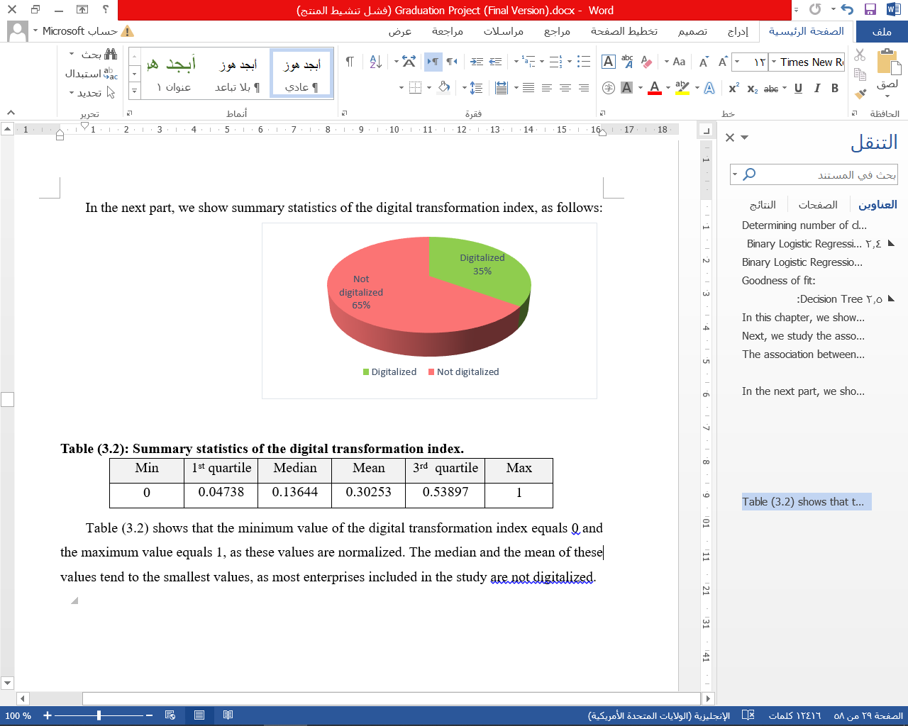
After applying the cluster analysis, enterprises are clustered into two categories, as follows:

Slide 22
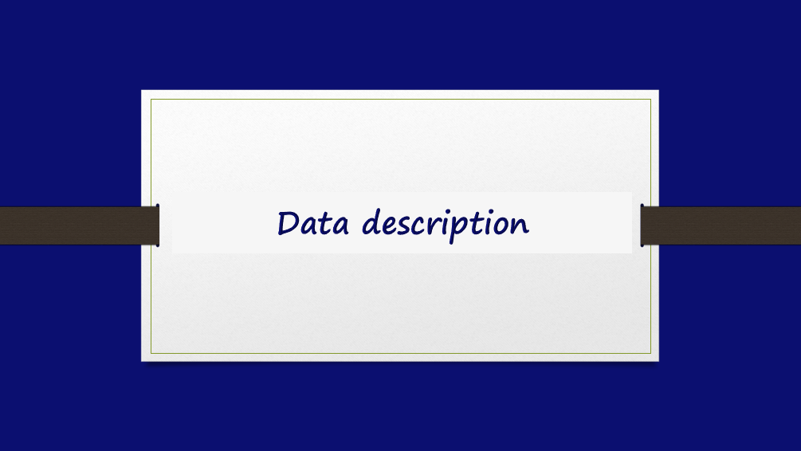

Slide 23
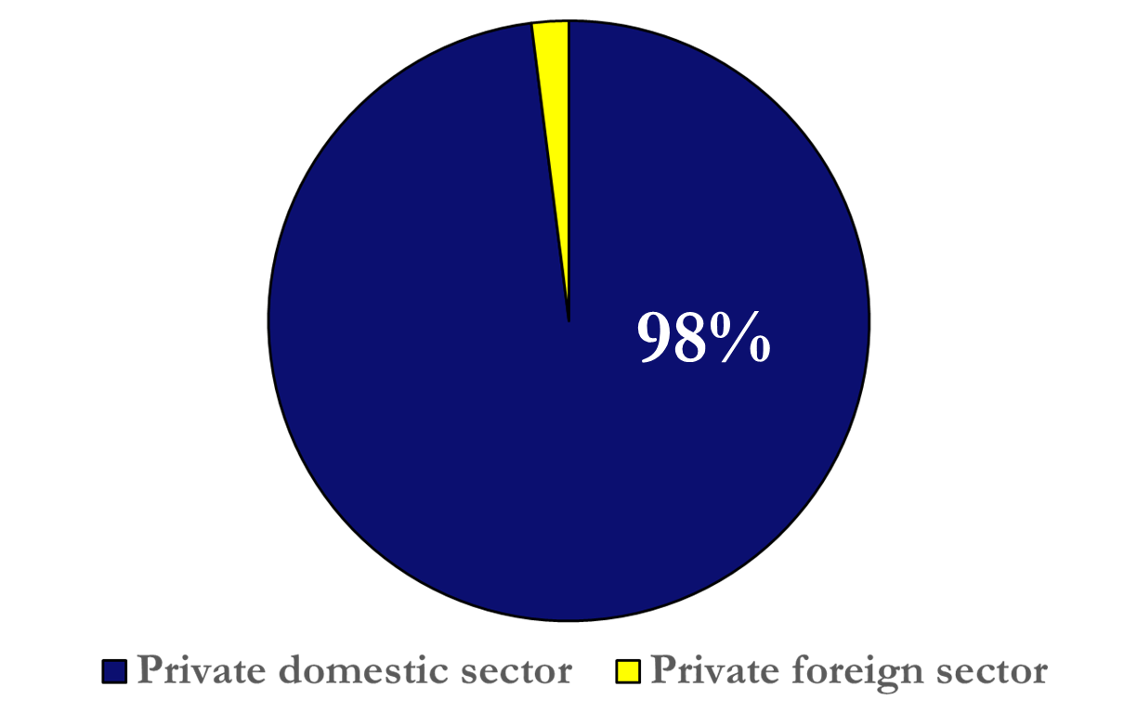
The type of sector

Slide 24
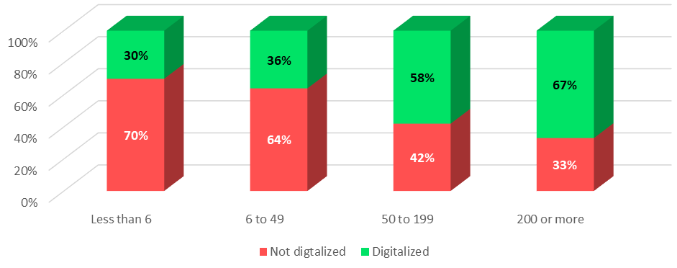
The Distribution of the DTI by
Human Capital

Slide 25
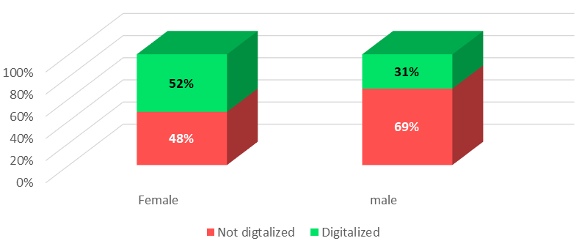
The Distribution of the DTI by
the sex of the owner

Slide 26
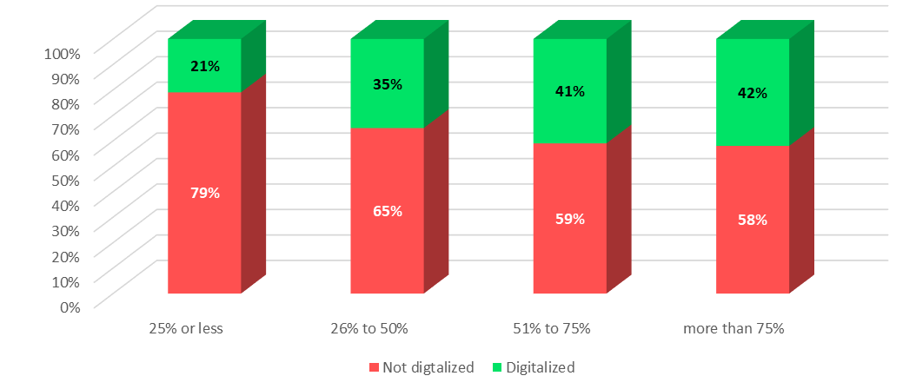
The Distribution of the DTI by the percentage of educated workers

Slide 27
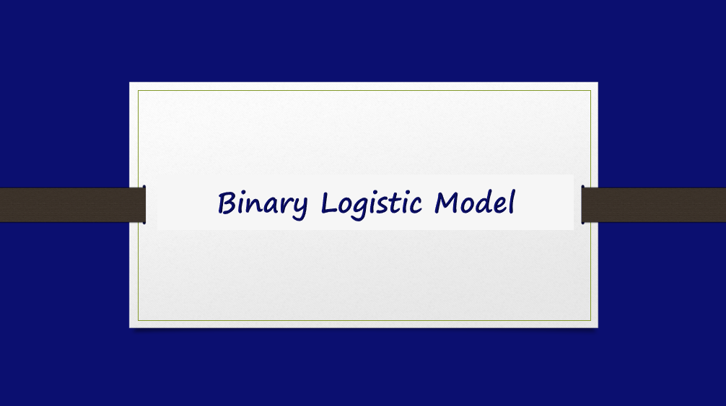

Slide 28
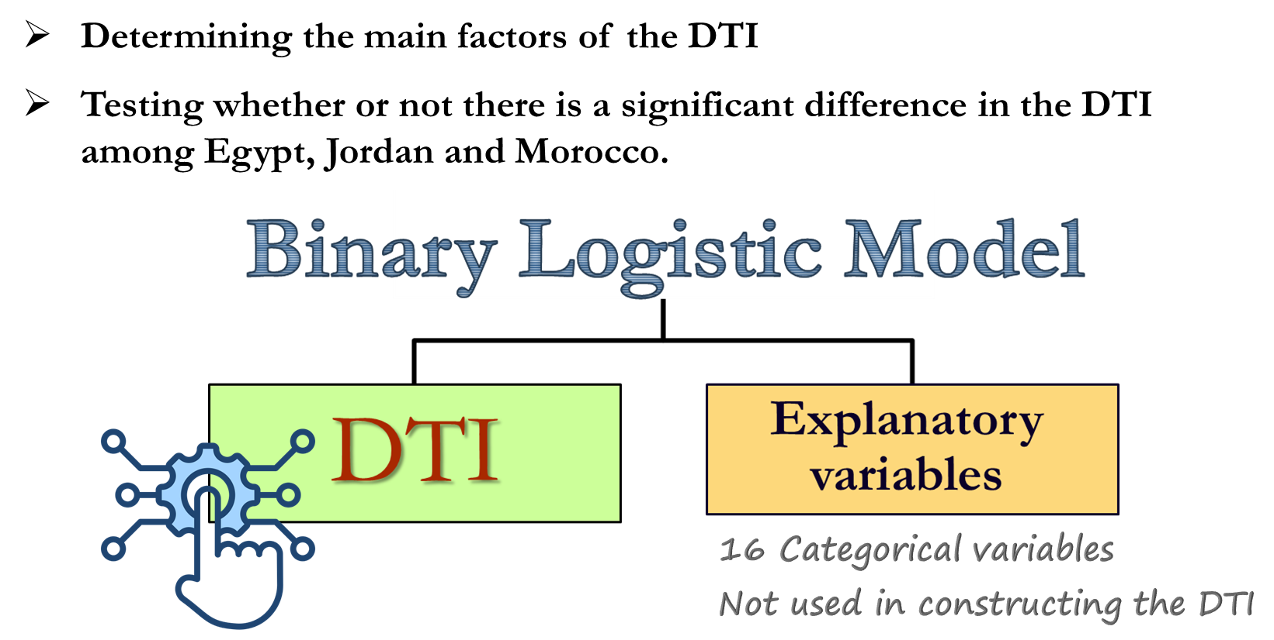

Slide 29
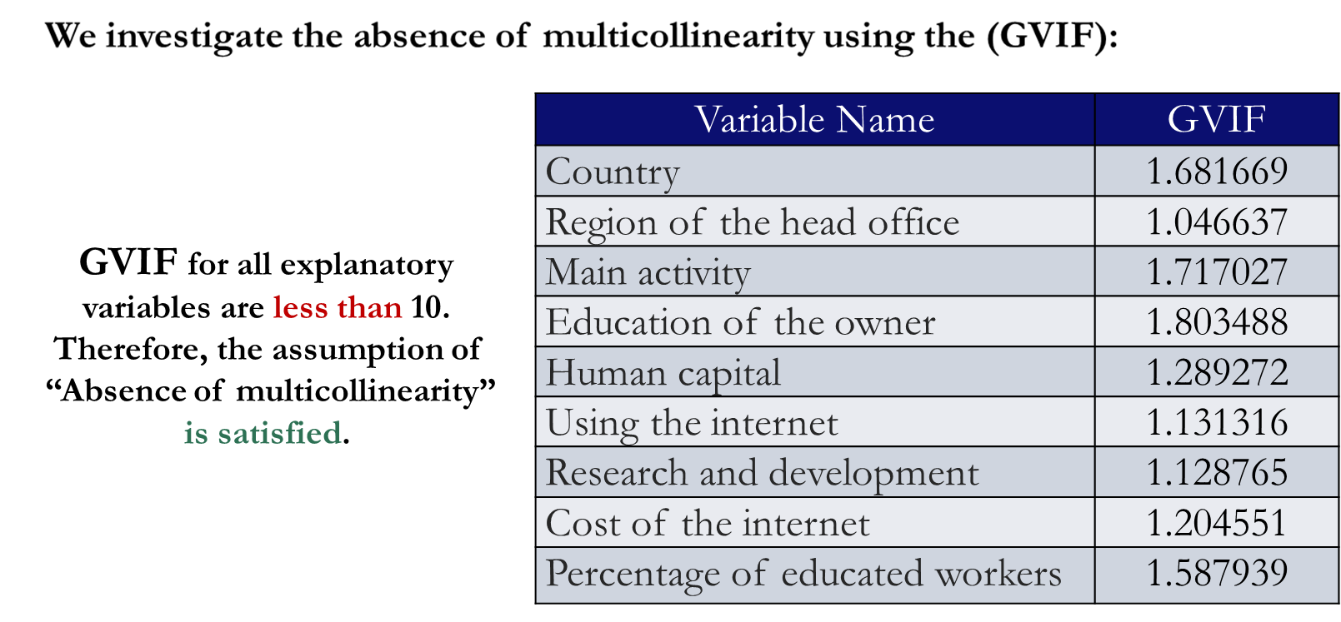

Slide 30
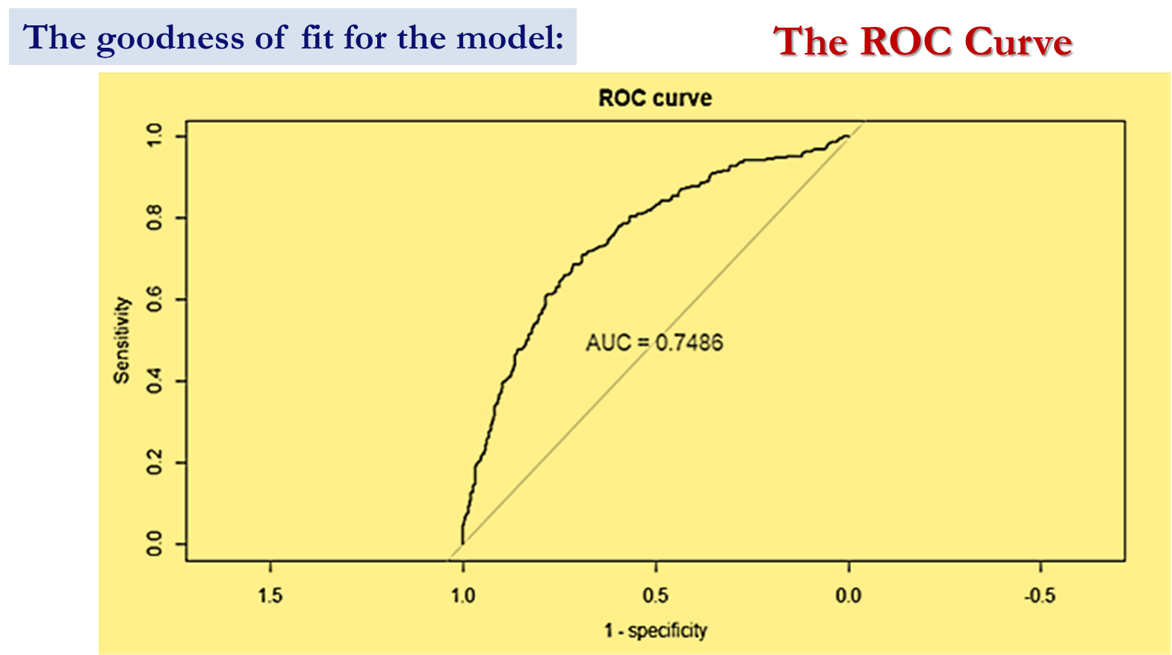

Slide 31
The goodness of fit for the model:
The classification table
 | True |  | Total
Predicted (classified) | Digitalized | Not digitalized
Digitalized | 226 (68.7%) | 181 (29.25%) | 407 (42.9%)
Not digitalized | 103 (31.3%) | 438 (70.75%) | 541 (57.1%)
Total | 329 (100%) | 619 (100%) | 948 (100%)
Accuracy =
70%
Sensitivity =
68.7%
Specificity =
70.75%

Slide 32
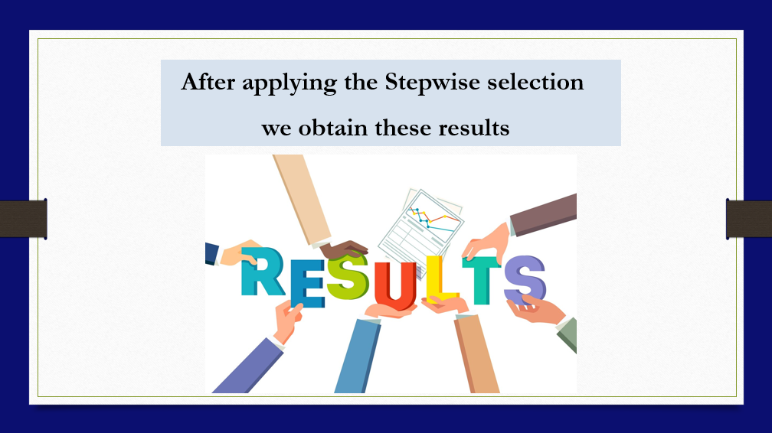

Slide 33
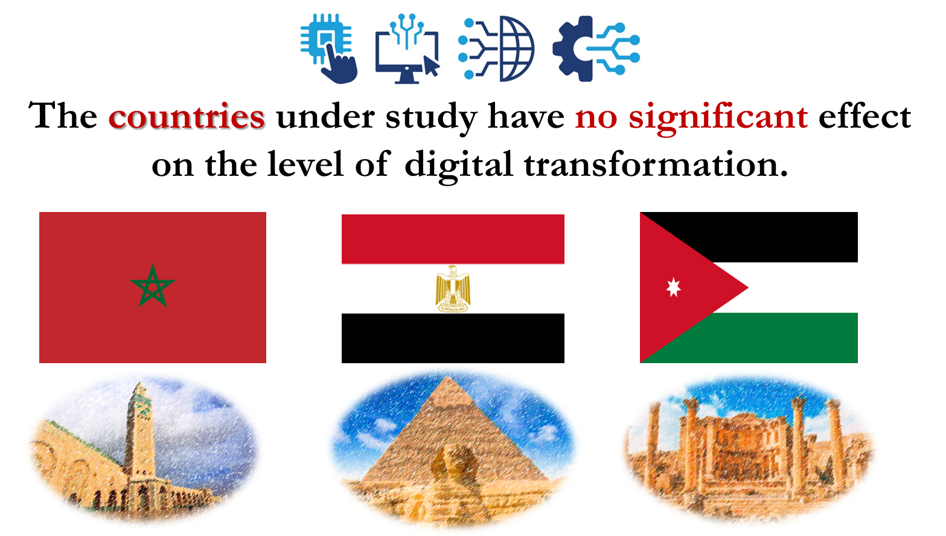

Slide 34
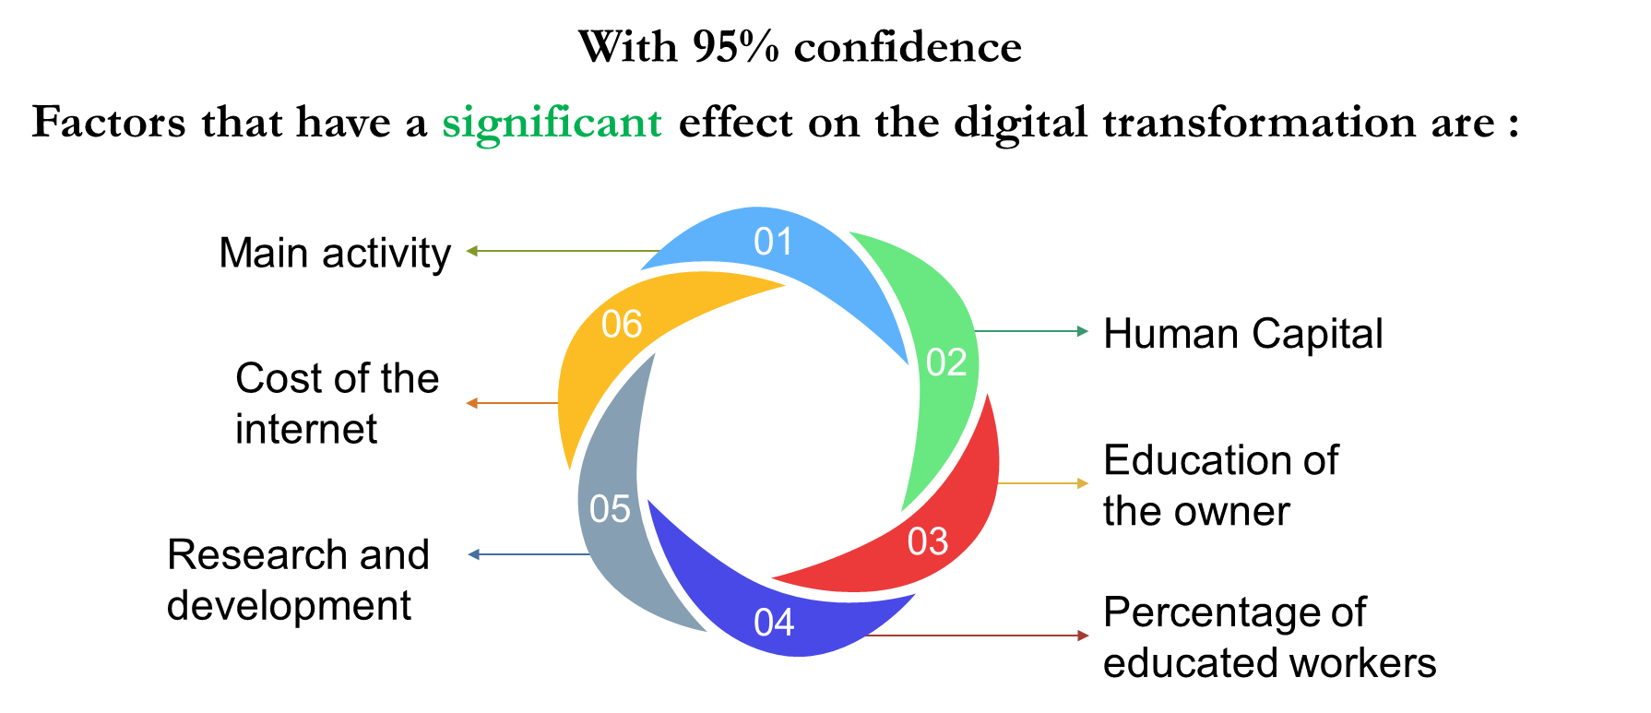

Slide 35
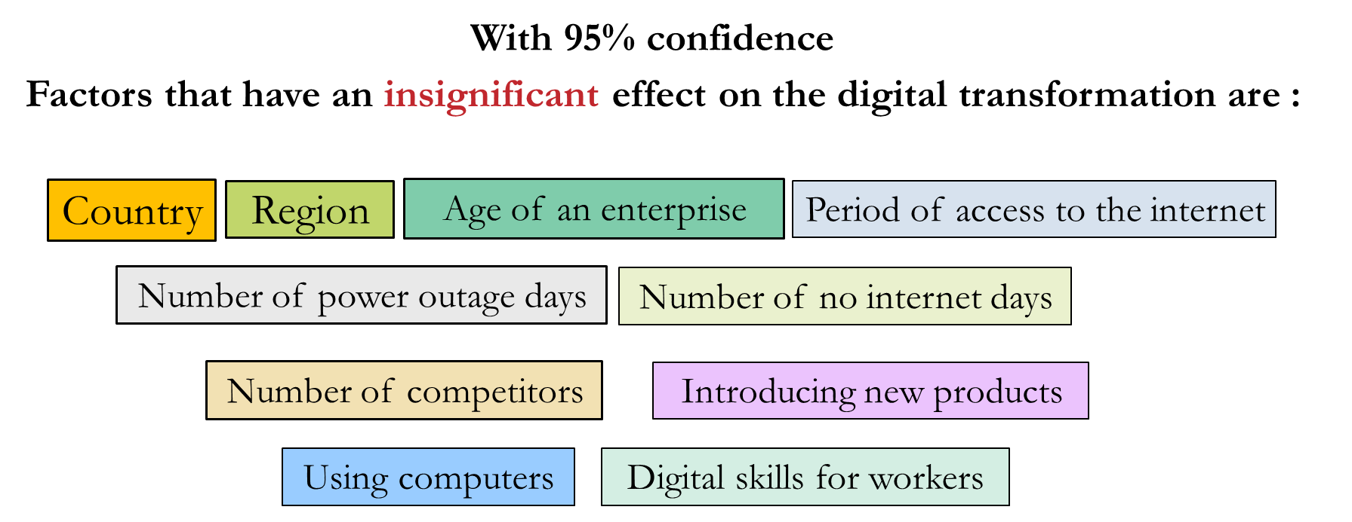

Slide 36
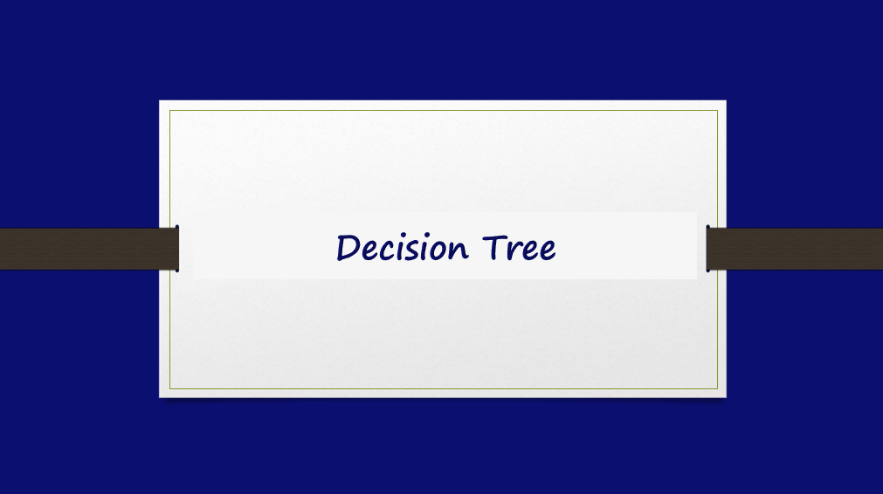

Slide 37
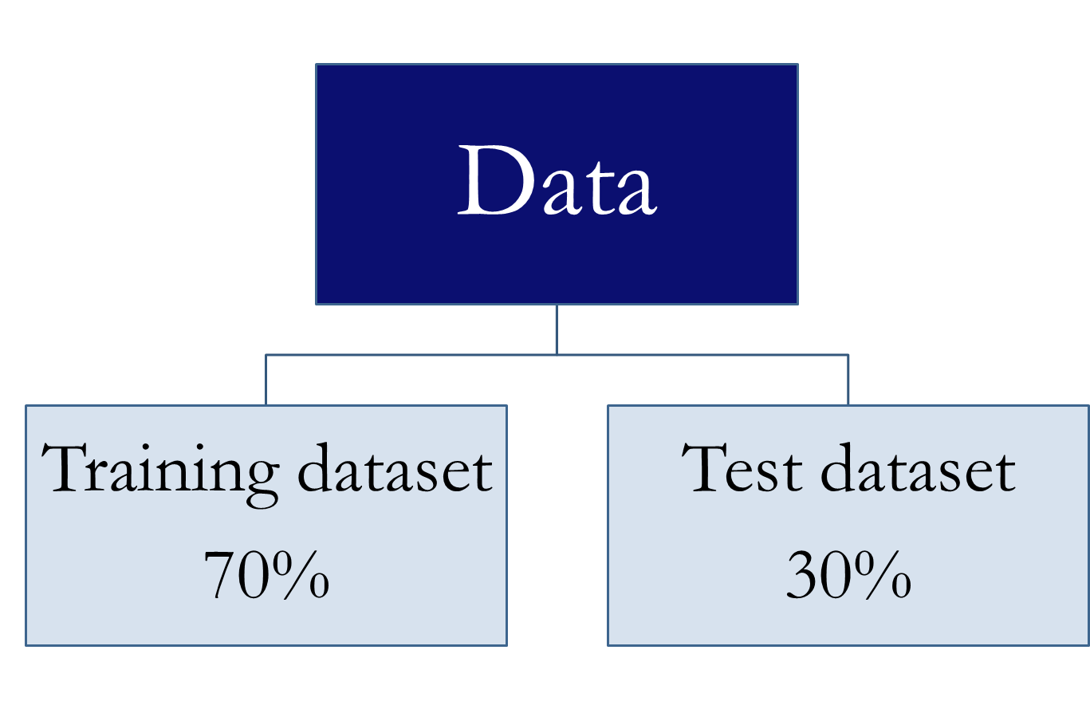

Slide 38
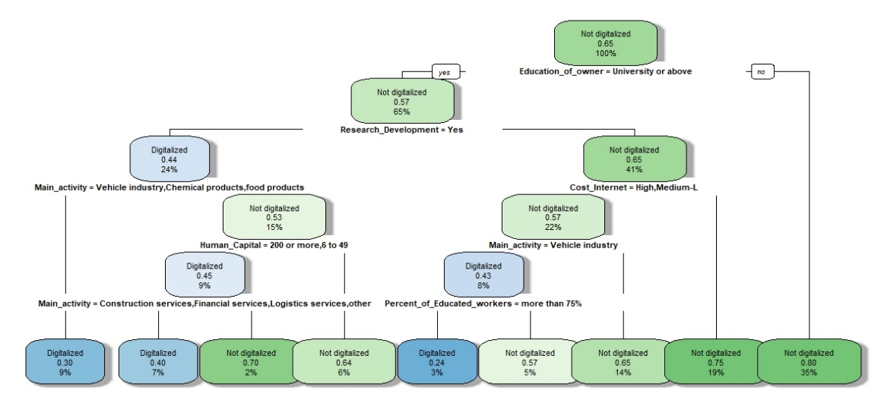

Slide 39
Importance of variables in splitting data.
Variable | Overall
Percentage of educated workers | 27.187527%
Main activity | 22.885368%
Research and development | 20.895093%
Education of the owner | 16.926351%
Cost of the internet | 9.244600%
Human capital | 9.080489%

Slide 40
The classification table
 | Reference (True) |  | Total
Predicted | Digitalized | Not digitalized
Digitalized | 35 (64.8%) | 65 (28.1%) | 100 (35.08%)
Not digitalized | 19 (35.2%) | 166 (71.9%) | 185 (64.92%)
Total | 54 (100%) | 231 (100%) | 285 (100%)
Sensitivity = 64.8%
Accuracy =
70.52%
Specificity= 71.9%

Slide 41
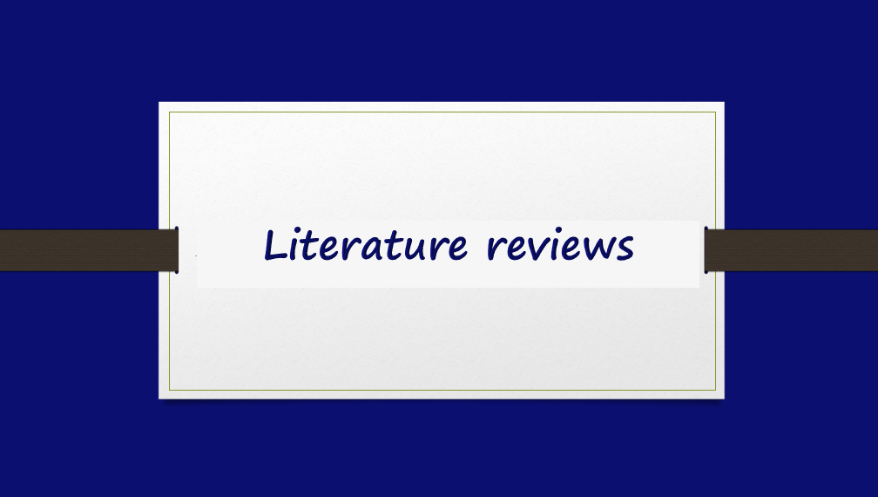

Slide 42
Construct an index:
Mohamed et al. (2022)
Mammadli and Klivak (2020)
Yakymova et al (2022)
The digital government authority of Saudi Arabia (2023)
Brondy and Tutak (2022)
Clustering
Brondy and Tutak (2021)
Kharlamov and Parry (2020)
Mies Et al (2023)

Slide 43
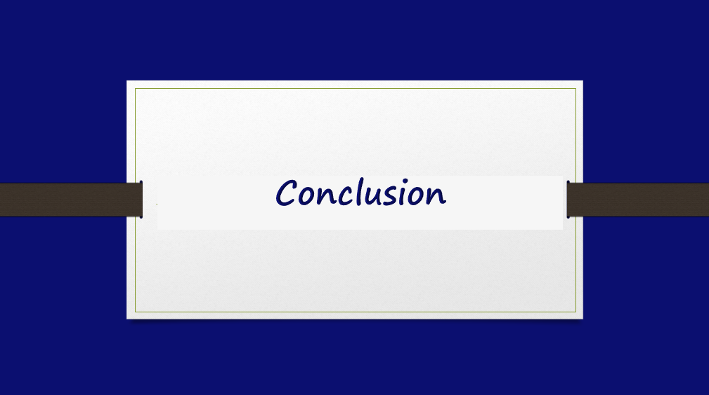

Slide 44
Insignificant
1
The digital transformation in the three countries does not show a significant difference
2
Poor Levels
The digital transformation level in three countries is currently low
Education
3
The most significant factor influencing digitalization is the education level of the enterprise owner or the percentage of educated workers
4
Human Capital
The larger number of workers an enterprise has, The more digitalized the enterprise is

Slide 45


Slide 46
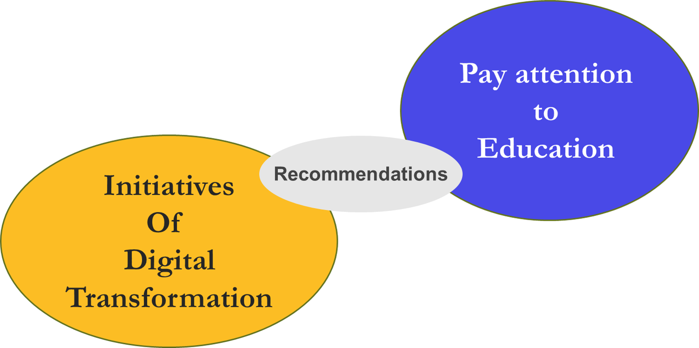

Slide 47


